Slide 1

Telecom
GTM Plan
May 07
Version 2.0

Slide 2

Executive
Overview
-
Keeping brand promises.

Slide 3
EXECUTIVE OVERVIEW
Telecom GTM Strategy
Two coordinated growth motions to build pipeline and expand strategic accounts
STRATEGIC
OBJECTIVE
Position Foundever as the strategic CX partner for telecom operators navigating revenue pressure, customer churn, rising operational costs, and increasing market commoditization.
01
New Logo Growth Engine
02
Existing Client Expansion
Scaled market activation across North America and EMEA
High-touch account-based engagement for strategic accounts
Objective Generate pipeline, validate market resonance, and identify high-intent telecom accounts.
Approach 90-day multi-channel campaign testing four telecom CX themes:
  • Differentiation
  • Loyalty & Retention
  • Revenue Growth
  • Efficiency & Cost-to-Serve
Channels Paid media, LinkedIn, person-based targeting, outreach, thought leadership, events.
Optimization Validate which messaging, content, and channels drive the strongest engagement signals, then scale investment toward highest-performing themes.
Objective Deepen executive relationships and accelerate account expansion opportunities.
Approach Bespoke 1:1 ABM motions aligned to each account’s commercial priorities.
  • Executive relationship mapping
  • Account-specific positioning & messaging
  • Personalized thought leadership
  • Executive events and roundtables
  • Tailored landing pages, outreach & sales orchestration
Priority Accounts Verizon • Charter • Granite • Breezeline/Cogeco
EXPECTED BUSINESS OUTCOMES
Pipeline generation
Paid + Person-Based Media
ABM Activation
Thought Leadership + Events
Message Testing
Accelerate qualified pipeline creation
Increase engagement within target accounts
Expand executive relationships in strategic accounts
Position Foundever as a strategic CX advisor
Identify highest-converting telecom narratives
Create connection. Value conversation.
01

Slide 4
New logos
New Logos Approach
GTM – New logo motion
14 target accounts | 5 telco segments | EMEA & North America
Segment
Target Accounts
Phase 1 · Weeks 1 – 4
Phase 2 · Weeks 5 – 8
Phase 3 · Weeks 9 – 12
MNO / Mobile
T-Mobile, Dish
Market Signal Validation
Awareness
Consideration
MVNO / Digital-first
Mint Mobile, TextNow
Test which CX challenge resonates most. Feed signals directly to sales.
Position Foundever as the strategic partner for telcos facing these challenges.
Surface proof points and drive high-intent engagement.
MSO / Cable
Comcast, Xfinity Mobile, Altice, Cable One, Midco, Mediacom
Fiber overbuilder
Windstream, TDS
>
eBook (4 challenge themes)
>
Telco Landing Page
>
Case Studies: Retention + Revenue
Satellite / Disruptor
HughesNet, Starlink
>
Display + Paid Search
>
Articles: Differentiation & Revenue
>
BOFU LinkedIn Amplification
Channels & Assets
Paid Media
Display Ads, Paid Search, Person-based targeting
>
Person-based targeting
>
MOFU LinkedIn + Social Listening
>
Roundtable Consortium + Innov. Day
Social
LinkedIn (TOFU / MOFU / BOFU), Social Listening
Events
Roundtable Consortium, Innovation Day
Assets
eBook x4, Landing Page, Articles, Case Studies, Email Nurture
Always-on: Email Nurture (Inside Sales) | Sales Intelligence Feed | Social Media Listening

Slide 5
ABM
ABM approach
GTM – Existing account strategy
For each account we build a bespoke activation — aligning to their commercial priorities, developing specific assets, and maintaining a continuous sales cadence to advance the relationship and build pipeline.
Account
Positioning angle
In progress
Kick off
Not scheduled
Verizon
Strengthen Foundever’s strategic position as Verizon consolidates suppliers from ~9 partners down to ~4 preferred providers.
Increase executive-level engagement beyond VP level into SVP and C-level relationships.
Position Foundever as a strategic CX and customer delight partner during Verizon’s AI and organizational transformation.
Support account growth from current ~$128M business toward $180–200M opportunity pipeline.
MNO
12 May 2026
In progress
Ryan Holder; Rebecca Mugford
Charter
TBD
MSO / Cable
19 May 2026
Kick off
Adil Charef; James Scodellaro
Granite
TBD
Fiber overbuilder
Not scheduled
Not scheduled
Fylma Kristile Fulks; Rebecca Mugford
Breezline / Cogeco
TBD
Regional Cable
Not scheduled
Not scheduled
Adil Charef; James Scodellaro
foundever

Slide 6
New logos
New Logo — Campaign Progress
Paid Media Kick-off
25 May 2026
Track
Activity
Status
Not started
In review
In progress
Complete
Outreach
Emails
Not started
Cadence kick-off
Not started
eBook
Final draft
In review
Ads for 4 challenges
In review
Landing page
Not started
Telco landing page
Content strategy
In progress
Design
Not started
Web development
Not started
foundever

Slide 7

Overview
Executive Summary
01
Market Context & Response
The industry faces four compounding challenges: revenue growth, loyalty, differentiation, and efficiency. Foundever's TC01-TC04 framework maps directly to each, positioning CX as a commercial growth lever
4 Key Challenges & 4 Key Outcomes
02
Media Plan
Executive Summary
A 90-day campaign across two phases — validating which CX challenge resonates most, then scaling into awareness and consideration.
Channels: Paid Media, Social Amplification, Sales Outreach & Events
Assets: eBook, Landing Page, Lead Gen Offer, Organic Content
This campaign positions Foundever as the key strategic partner for telco CX.
03
Next Steps & Priorities
Finalize landing page direction, lead gen offer and ABM approach. Define customized ABM approach for priority accounts with account management. Align on organic social media plan and field marketing.
Cross-functional alignment: Solutions, Marketing, Sales & SMEs
04
Appendix
Content direction overview & distribution plan for eBook, landing page, emails & ADs.
7

Slide 8
Market context & Foundever response
-
Keeping brand promises.

Slide 9

Differentiation
Telcos are becoming commoditized, being involved in a crisis of customer value and brand loyalty.
Telcos know CX is critical—but capital constraints prevent investment. Yet underinvesting in CX is what's creating the constraint in the first place.
The investment paradox
Capital is locked
Why it happens
CX is a key trigger
What’s at stake
Flat revenue, costs rising
24%
73%
9 years
Lower capital spending expected from 2024-2028 [1]
Telcos past investments heavily in the past in legacy systems, fiber, and expansion [2]
Of customers consider experience a key driver of loyalty [2]
77% of consumers feel no loyalty to their provider and connectivity hasn’t provided the differentiation it needed [2]
Of continuous drop in ARPU, despite investing in 5G connectivity [3]
86% of consumers are willing to pay more for a better experience [2]
Converged customers are 19% more likely to be net promoters than non-converged customers [4]
Failure to differentiate
Lower ARPU, fighting on pricing
[1] Scope Ratings, European telecoms: leverage points to decade lows as the decline in capital investment continues
[2] Deloitte, 2026 Global Telecommunications Industry Outlook
[3] Connect Europe, 2026 State of Digital Communications 2026
[4] Key Trends in Fixed-Mobile Convergence FTI
9

Slide 10

Core challenges |  |  | Foundever Response
Strong need to stand-out Network parity has eliminated traditional differentiation. Customers expect real-time, omnichannel service and operators deploying AI are yet to turn that investment into better experiences. | → | Differentiation | Elevate CX to a competitive advantage Deliver faster resolution with fewer handoffs, consistent omnichannel experiences, and reduced friction across billing, installation, and service.
Accelerated churn Switching has never been easier. Churn and price pressure are eroding margins in saturated markets, and one poor interaction is all it takes to lose a customer you spent months acquiring. | → | Loyalty | Protect and reduce churn at scale Detect churn signals early, optimize save-desk performance at cancellation, and drive proactive engagement during billing shocks and outages..
Acquire, convert & retain ARPU is flat despite a strong install base. Every carrier is fighting to own the household through convergence. The upsell conversation exists but rarely happens at the right time, through the right channel. | → | Revenue Generation | Grow the household revenue base Drive subscriber acquisition efficiency, increase ARPU through bundling and upsell, and improve conversion across the full household relationship — from acquisition to care to expansion.
Strong cost pressure Operational models are fragmented and cost-heavy. Contact volumes keep rising while margins compress, and compliance requirements like FCC add structural cost that is hard to absorb. | → | Efficiency | Scale profitably in a high-disruption environment Lower cost-to-serve through intelligent automation, elastic capacity during demand spikes, and compliance-ready onshore/nearshore delivery.
Notes:
The upshot: the industry is currently in a situation where almost all the cash it generates is absorbed by capital expenditures, dividends, and servicing debt—leaving very little for investment in innovation or enhanced customer experience.

Slide 11
GTM
Strategy
-
Keeping brand promises.

Slide 12
GTM strategy: existing clients vs. new logos
New Logo Motion – Always-on
1:1 ABM Motion - NA
NA & Select EMEA
Define key theme to GTM with sales
Raise awareness for top level accounts
Identify 'hand raisers' that can move into high-touch targeted motions.
Continue to test and learn what works for each market — content, messaging, and creative across all themes
Targets: HughesNet, Starlink, Windstream, T-Mobile, Dish, TextNow, Xfinity Mobile, Comcast, Mint Mobile, Altice, Cable One, Midco, TDS, Mediacom
• Microsites for downloadable lead generation asset
• Articles on the specific market context between US
• Motions targeting current account: Verizon, Charter, Granite, Breezline / Cogeco.
1:1 ABM Motion - EMEA
Define key theme to GTM with sales
Capture data on:
Accounts as they move in and out of market | Message theme resonance | Intent signals
• Microsites for downloadable lead generation asset
• Articles on the specific market context between EMEA level & UK regulations
• Define targeting with EMEA Global.

Slide 13
90-day – Distribution & market activation plan (new logos)
PHASE 1: Market Signal Validation
PHASE 2: Conversion Optimization & Asset Expansion
Test –Define which CX challenge resonates most across EMEA and US, build momentum, and activate accounts.
Awareness – Inform the unaware. Position Foundever as the partner for telcos facing these challenges.
Consideration – Bring awareness to Foundever's internal capabilities and market proof points.
Week 1
Week 2
Week 3
Week 4
Week 1
Week 2
Week 3
Week 4
Week 1
Week 2
Week 3
Week 4
Paid Media
Social Amplification
Outreach & Events

Slide 14
90-day – Distribution & market activation plan (new logo)
PHASE 1: Market Signal Validation
PHASE 2: Conversion Optimization & Asset Expansion
Test –Define which CX challenge resonates most across EMEA and US, build momentum, and activate accounts.
Awareness – Inform the unaware. Position Foundever as the partner for telcos facing these challenges.
Consideration – Bring awareness to Foundever's internal capabilities and market proof points.
Week 1
Week 2
Week 3
Week 4
Week 1
Week 2
Week 3
Week 4
Week 1
Week 2
Week 3
Week 4
eBook
Display ADs + SEA for theme #1 (Differentiation)
Person-based marketing + Paid search
Landing Page Telco (+discovery call)
Display Ads + Paid Search
Person-based marketing + Paid Search
eBook
Display ADs + SEA for theme #2 (Loyalty)
Person-based marketing + Paid Search
Article Differentiation & Revenue Generation
Display Ads
Person-based marketing
Case Study Retention (gated)
Display Ads
Person-based marketing
eBook
Display ADs + SEA for theme #3 (Revenue Generation)
Person-based marketing + Paid Search
Article Retention
Display Ads
Person-based marketing
Case Study Revenue Generation (gated)
Display Ads
Person-based marketing
eBook
Display ADs + SEA for theme #4 (Efficiency)
Person-based marketing + Paid Search
TOFU Social Amplification SME
LinkedIn Posts
Social Media Listening
MOFU Social Amplification SME
LinkedIn Posts
Social Media Listening
BOFU Social Amplification SME
LinkedIn
Social Media Listening
Emails
Inside Sales
Roundtable Consortium
Field Marketing
Innovation Day
Field Marketing

Slide 15

Punchlist
Next steps & dependencies
Action
Item
Stakeholder
Target Deadlines
ABM approach
definition
Verizon: Ryan Holder; Rebecca Mugford
Charter: Adil Charef; James Scodellaro
Granite: Fylma Kristile Fulks; Rebecca Mugford
Breezline (owned by Cogeco): Adil Charef; James Scodellaro
Customized ABM Plan
Define together with sales what to include within the ABM strategy (ie. Microsites,
TBD – requires 1-1 support with account management
Finalize Landing Page &
Lead Gen Offer
Workshops with SMEs
Validate with SMEs the current laning page direction, identify use cases and define the lead gen offer to put forward.
Solutions Marketing
25.05.2026
SMEs
Finalize eBook
Workshops with SMEs
Review the current draft and validate the direction.
Sales & SMEs
25.05.2026
Sales & SMEs
Organic Social
Media Plan &
Events
GTM Workflow
Define a working plan with the Global Social Media team, Field Marketing and our SMEs to frame the key messaging pillars for content creation & the event strategy.
Global Social Media
TBD – requires coordination with events & social media teams
Sales & SMEs
Field Marketing

Slide 16
Appendix
-
Keeping brand promises.

Slide 17
1
Hero Assets
-
Keeping brand promises.

Slide 18

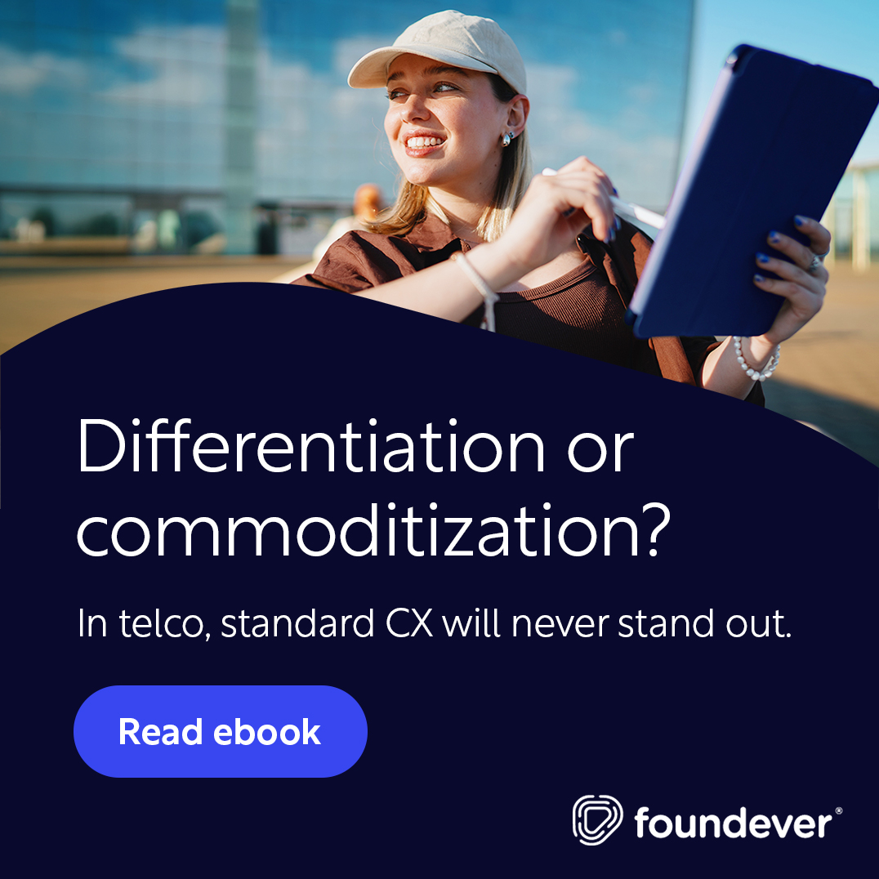


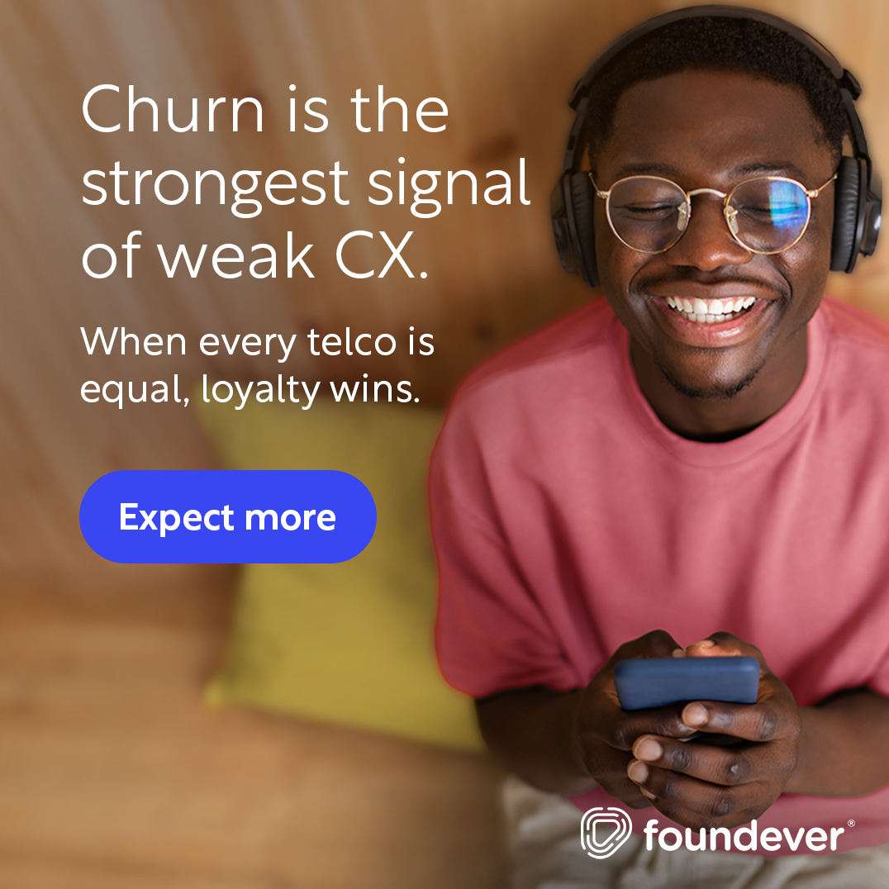
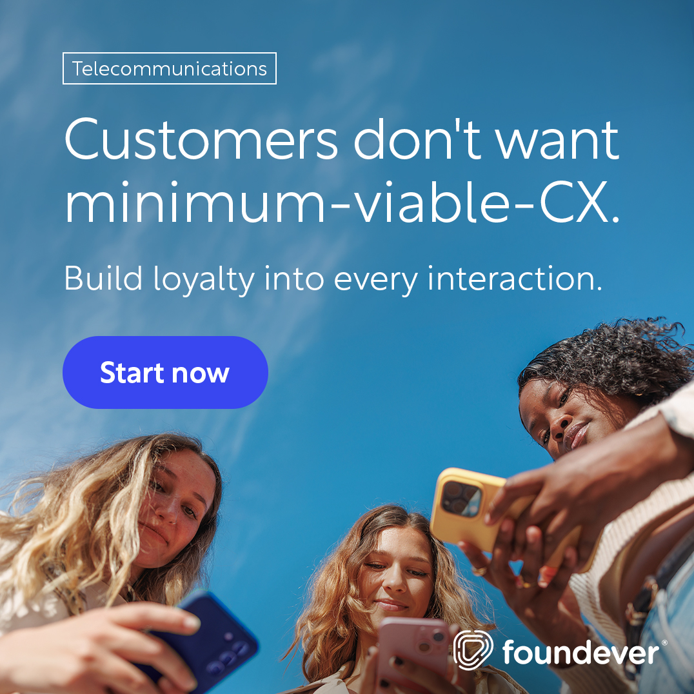

Asset 1
eBook: The 4 challenges every Telco
should overcome in 2026
To be updated
Objective
Generate interest in the awareness phase by testing out the main market challenges. Position Foundever as the go-to voice on Telco CX. Build the retargeting pool.
Message
The eBook is focused on helping telcos escape commoditization by taking apart the key challenges this vertical is experiencing. The eBook ends with practical advice and market PoV – which still need to be established.
CTA
Primary: Download the eBook Secondary: Talk to an Telco CX expert (30-min working session)
Marketing Ops
Hosted: Hubspot Distribution: LinkedIn Paid, Influ2, Google SEA Flow: The visitors are pushed to a "Talk to an expert" CTA, which routes to a mid-funnel thank-you page. Non-converters get retargeted across LinkedIn and display.

Slide 19
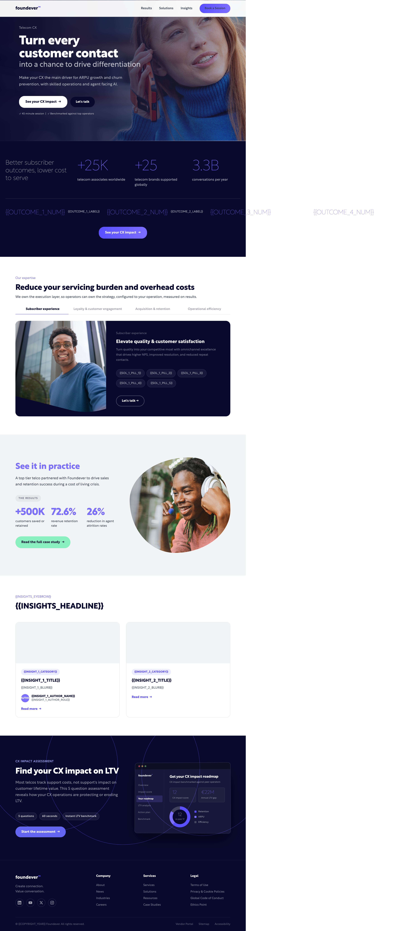
Asset 2
Landing Page: Turn customer contact into differentiation
Objective
Drive engagement through mid-of-the-funnel activations Position Foundever as the go-to voice on Telco CX.
Message
Foundever’s landing page to drive the vertical key positioning and our expertise within the market.
CTA
Primary: Find your CX impact on LTV Secondary: Talk to an Telco CX expert (30-min working session)
Marketing Ops
Hosted: Foundever.com Distribution: LinkedIn Paid, Influ2, Google SEA Flow: The visitors are pushed to a "Talk to an expert" CTA, which routes to a mid-funnel thank-you page. Non-converters get retargeted across LinkedIn and display.

Slide 20
2
Outreach Design
-
Keeping brand promises.

Slide 21
First 30 days
Verticalized Outreach
Phase 1 · Days 1–10
Broad outreach — same messaging for all contacts
Day 1
Day 1
Day 3
Day 4
Day 7
Day 10
1
2
3
4
5
6
in
✉
✆
✉
✉
in
Connection
Request
FCC
Repatriation
Call /
pitch
Voicemail
follow-up
Outcomes
vs hours
LinkedIn
touch
Phase 2 · Days 11–30
Persona-based — split by function, seniority shapes channel intensity
Day 12
Day 16
Day 21
Day 26
Retention / Care
The save model
Passive churn play
CSAT as revenue
Final CTA
Collections
RPC at scale
Promise-to-pay
Roll rate reduction
Final CTA
Tech Support
FCR uplift
Escalation containment
AHT vs CSAT
Final CTA
Sales
ARPU protection
Rep ramp speed
Upsell playbook
Final CTA
Finance / CFO
Rebadge ROI
Repatriation cost
Outcomes vs FTE
Final CTA
Notes:
Mark people in fields, role retention care

Slide 22
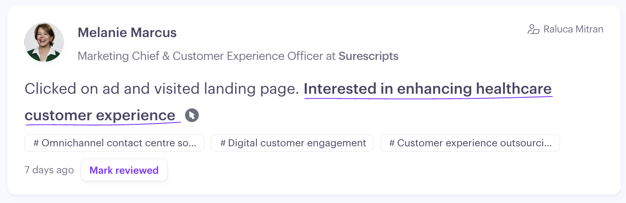
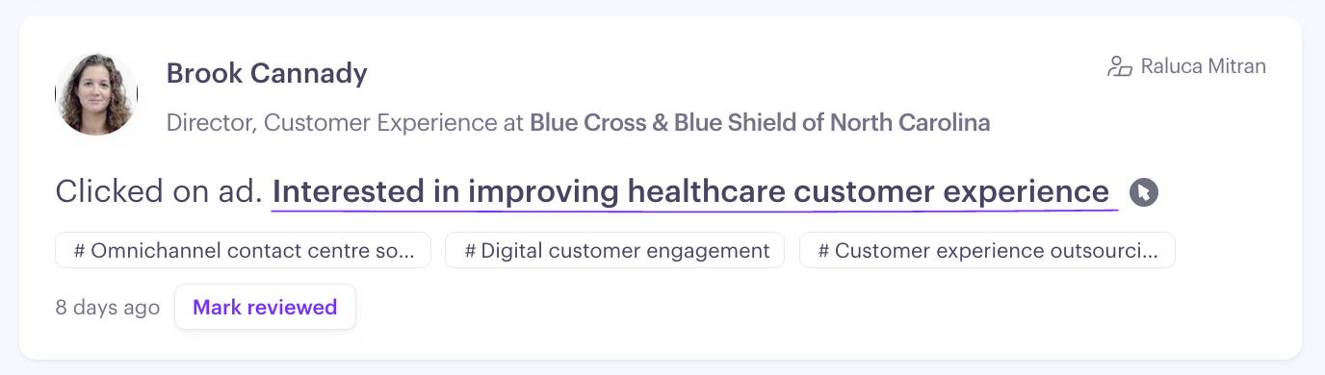
After 30 days
Personalized Message
Sub-group
Persona
Sales Intelligence first 30 days
Integrated service provider
x
Alternative Operators
x
Enterprise wholesale providers
C-level
x
Procurement
x
CX
x
x
Notes:
Ad 1 – Question (Q) & Statement (S)
Q A: Is your organization prepared for the next wave of change?
Q B: Are you positioned to turn the next disruption into an opportunity?
S: Unlock the power of AI for unmatched support, flexibility and resilience.
Ad 2 – Question (Q) & Statement (S)

Slide 23


z
Asset 4
Emails & ADs: Differentiation – elevate quality & customer satisfaction
C-level & Procurement
CX & Ops above
Display ADs
Display ADs
Struggling to stand out?
See the 4 challenges telcos must solve to escape commoditization— and win board-level approval.
→ Download the eBook
8 out of 10 telco customers deem CX as important.
See how the right CX infrastructure delivers measurable results your finance team will approve.
→ Download eBook
Sales Outreach
Sales Outreach
What working with 25+ telco taught us about unlocking capital for CX
Capital is locked in 5G and fiber—investments that haven't moved ARPU. Meanwhile, 86% of customers would pay more for better CX.
The paradox: You can't afford CX investment, but underinvesting in CX is worsening the capital constraint.
→ Book a call – learn how to break the cycle
What working with 25+ telco taught us about differentiation
The telcos escaping commoditization share one approach: AI-enabled omnichannel operations that deliver measurable outcomes—higher NPS/CSAT, improved FCR, reduced repeat contacts.
The result: Quality becomes your competitive moat, not another cost center fighting for budget.
→ Book a call – build a business case
Notes:
CX & Operational Pain Points
• CX perception gap: 80% of bank executives believe they offer superior CX, but only 24% of customers agree.²
• Silent churn threat: 1 in 4 Europeans switched their main bank in the last 5 years. Of those, 33% left due to poor customer experience.⁴
• Digital dissatisfaction: 26% of customers have already switched banks due to weak digital offerings. 59% want tailored financial recommendations.⁵
• Cost-to-serve challenge: Fragmented tech, talent, and process models across markets raise costs, slow transformation, and reduce consistency.²
Customer Expectations Across Key EMEA Markets
• Personalisation at scale: Customers increasingly expect hyper-personalized digital experiences on par with leading e-commerce platforms.⁵
• Speed & omnichannel: Growth in mobile-first engagement—especially in the Nordics and GCC—drives demand for seamless transitions between digital and human channels.⁶
• Trust & security: Data privacy and fraud protection remain top loyalty drivers in mature EMEA markets like Germany and the UK.³
Revenue & Loyalty Impact from Silent Churn and Complexity
• ARPU erosion: Losing the primary relationship reduces product density, data access, and engagement frequency.⁴
• Retention at risk: Promoters have 2.3× lower risk of switching and 2.5× higher lifetime value compared to detractors.⁷

Slide 24
z
Asset 4
Emails & ADs: Loyalty – proactively reduce churn
C-level & Procurement
CX & Ops above
Display ADs
Display ADs
73% of telco customers say CX wins their loyalty.
Yet churn is still eating your balance sheet
See the 4 customer challenges telcos must solve to stop the capital drain.
→ Download eBook
Struggling to drive customer ‘stickiness’?
Telcos record 22% higher churns globally.
Learn to identify at-risk customers & win loyalty from day one.
→ Download eBook
Sales Outreach
Sales Outreach
Why [Company] doesn’t win loyalty
Most operators CAPEX goes to network and customer acquisition—but retention gets a fraction of acquisition spend. The result: Telcos are struggling with 22% higher churn, while 77% of consumers feel no loyalty to their provider and connectivity hasn’t provided the differentiation it needed. Happy to share how proactive retention can help and win loyalty.
→ Worth a quick chat?
Why your churn rates keep rising
Annual churn rates are 22% higher, while 73% of telco customer would keep their loyalty for a better customer experience. The breakpoint is your CX infrastructure— that should enable proactive customer retention and loyalty from day 1. We work with +25 telco globally. Happy to share what we’re seeing in your specific space.
→ Worth a quick chat?

Slide 25
z
Asset 4
Emails & ADs: Revenue generation – Accelerate customer revenue
C-level & Procurement
CX & Ops above
Display ADs
Display ADs
ARPU remains flat, while costs are rising?
See which tactics telcos can use to drive customer value— and win board-level approval.
→ Download eBook
86% of telco customers would pay more for better CX.
See how the right CX strategies can improve your conversion rates.
→ Download eBook
Sales Outreach
Sales Outreach
How a top telco drove 72.6% revenue retention
By adopting a multichannel, best-time-to-call approach to sales and retention, the team increased the answer rate and call-back rates by 20% and served 1,052,851 meaningful interactions across synchronous and asynchronous channels. This helped the team retain 551,197 customers.
→ If you’re evaluating CX partners, it’s worth having us in the conversation.
How a top telco drove 72.6% revenue retention
By adopting a multichannel, best-time-to-call approach to sales and retention, the team increased the answer rate and call-back rates by 20% and served 1,052,851 meaningful interactions across synchronous and asynchronous channels. This helped the team retain 551,197 customers.
→ If you’re evaluating CX partners, it’s worth having us in the conversation.
Notes:
CX & Operational Pain Points
• CX perception gap: 80% of bank executives believe they offer superior CX, but only 24% of customers agree.²
• Silent churn threat: 1 in 4 Europeans switched their main bank in the last 5 years. Of those, 33% left due to poor customer experience.⁴
• Digital dissatisfaction: 26% of customers have already switched banks due to weak digital offerings. 59% want tailored financial recommendations.⁵
• Cost-to-serve challenge: Fragmented tech, talent, and process models across markets raise costs, slow transformation, and reduce consistency.²
Customer Expectations Across Key EMEA Markets
• Personalisation at scale: Customers increasingly expect hyper-personalized digital experiences on par with leading e-commerce platforms.⁵
• Speed & omnichannel: Growth in mobile-first engagement—especially in the Nordics and GCC—drives demand for seamless transitions between digital and human channels.⁶
• Trust & security: Data privacy and fraud protection remain top loyalty drivers in mature EMEA markets like Germany and the UK.³
Revenue & Loyalty Impact from Silent Churn and Complexity
• ARPU erosion: Losing the primary relationship reduces product density, data access, and engagement frequency.⁴
• Retention at risk: Promoters have 2.3× lower risk of switching and 2.5× higher lifetime value compared to detractors.⁷

Slide 26
Theme 4
Efficiency
Optimize cost-to-serve
z
Asset 4
Emails & ADs: Efficiency – Optimize cost-to-serve
C-level & Procurement
CX & Ops above
Display ADs
Display ADs
Capital locked in 5G, while costs keep rising?
See how telcos optimize cost-to-serve without cutting quality — and win board-level approval.
→ Download eBook
AI-powered CX ops cut cost-to-serve without cutting standards.
See how intelligent automation and right-shoring reduce cost-to-serve at scale.
→ Download eBook
Sales Outreach
Sales Outreach
How [Company] can do more with less in CX
High-volume contact centres are the biggest cost driver for most telcos. But cutting headcount isn’t the answer — it hurts CX and accelerates churn. AI-powered self-service, demand reduction, and right-shoring reduce costs while maintaining quality at scale. Happy to share how this works in practice..
→ Worth a quick chat?
How AI-powered CX ops reduce cost-to-serve without cutting quality
Telcos face rising cost pressure with little room to invest. Capital locked in 5G means efficiency can’t wait. AI-powered automation, right-shore operations, and contact demand reduction cut cost-to-serve without cutting quality. We work with 25+ telco operators globally. Happy to share what we’re seeing in your market..
→ Worth a quick chat?
Notes:
CX & Operational Pain Points
• CX perception gap: 80% of bank executives believe they offer superior CX, but only 24% of customers agree.²
• Silent churn threat: 1 in 4 Europeans switched their main bank in the last 5 years. Of those, 33% left due to poor customer experience.⁴
• Digital dissatisfaction: 26% of customers have already switched banks due to weak digital offerings. 59% want tailored financial recommendations.⁵
• Cost-to-serve challenge: Fragmented tech, talent, and process models across markets raise costs, slow transformation, and reduce consistency.²
Customer Expectations Across Key EMEA Markets
• Personalisation at scale: Customers increasingly expect hyper-personalized digital experiences on par with leading e-commerce platforms.⁵
• Speed & omnichannel: Growth in mobile-first engagement—especially in the Nordics and GCC—drives demand for seamless transitions between digital and human channels.⁶
• Trust & security: Data privacy and fraud protection remain top loyalty drivers in mature EMEA markets like Germany and the UK.³
Revenue & Loyalty Impact from Silent Churn and Complexity
• ARPU erosion: Losing the primary relationship reduces product density, data access, and engagement frequency.⁴
• Retention at risk: Promoters have 2.3× lower risk of switching and 2.5× higher lifetime value compared to detractors.⁷

Slide 27
2- ABM plays
-
Keeping brand promises.

Slide 28
Strengthening Foundever’s Strategic Position at Verizon
Goal
Protect and expand Foundever’s strategic footprint
Increase executive visibility during organizational transformation
Supporting our AMs to drive account growth from current ~$128M business toward $180–200M opportunity pipeline.
Execution
Executive thought leadership
Non-intrusive account-based engagement
Verizon-specific CX and AI narratives
Executive workshops and peer discussions
#1: Strengthen Foundever’s strategic position as Verizon consolidates suppliers from ~9 to ~4.
#2: Increase executive-level engagement beyond VP level into SVP and C-level relationships.
28
28
V.1.0: Internal use

Slide 29
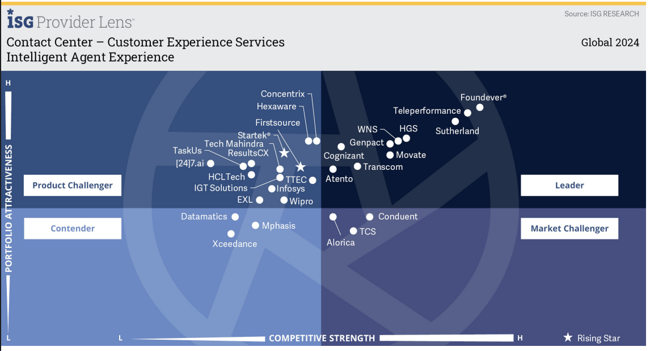
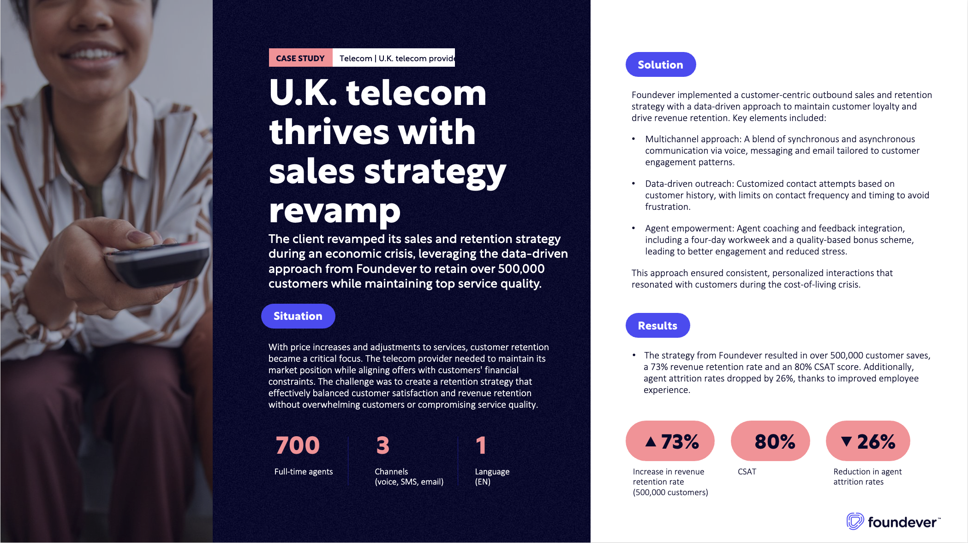
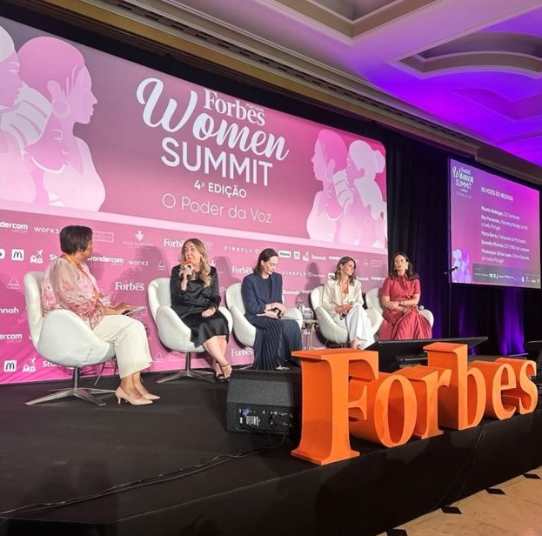
ABM Verizon
Strategic areas of focus
Event
No Input
For context/
information
Designed/In development
Requires minimal change
Discussion
Immediate
Launch
Short-Term
Launch
Long-term Development
0-15 days
15-45 days
45 -60 days
Reinforce Foundever’s role in supporting Verizon’s customer delight strategy through premium CX expertise and telecom industry leadership.
Position Foundever as a strategic partner helping Verizon compete in the convergence era through customer delight, retention, and revenue growth.
Build senior executive partnerships around Verizon’s customer delight and AI transformation priorities.
Assets:
ISG / Everest analyst validation
Whitepaper Gen AI
eBook on 4 Telcom challenges
Executive LinkedIn amplifications
Executive relationship mapping & engagement
Assets:
Case studies on revenue generation & CSAT
Landing page (Verizon)
“Customer Delight at Scale” thought leadership
Assets:
CX Data Audit – gathering and using the right data to build your CX strategy
Executive roundtables / peer discussions
Building the Agentic CX Ecosystem for Telecom
WiX & Foundever:
Leading CX when the playbook
keeps changing

Slide 30
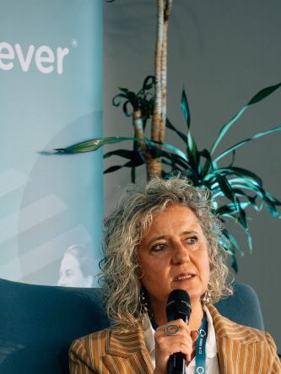

WiX & Foundever:
Leading CX when the playbook keeps changing
Activation 1
WiX & Foundever
Leading in CX when the playbook keeps changing
Audience
Verizon SVPs+ in CX, care and consumer ops Senior peers from American Express, Delta, Disney ( similar CX benchmark brands) 15–25 attendees, invite-only
Why this event
Roundtable creates a peer environment — senior Verizon leaders show up for the topic, not the vendor
Objective
Secure 3–5 senior executive 1:1 follow-up meetings with Verizon SVPs+ within 30 days Close the SVP+ gap flagged by Ryan in May 2026 discovery Position Foundever as a peer convener, not a vendor
Event
Message
Working line: "Leading CX when the playbook keeps changing" Peer conversation among senior women shaping CX at brands setting the standard Themes: holding a customer-delight vision through reorgs, leading teams through AI-driven change, the next five years of CX leadership Not a panel. Not a pitch..
Marketing OPS
TBD

Slide 31
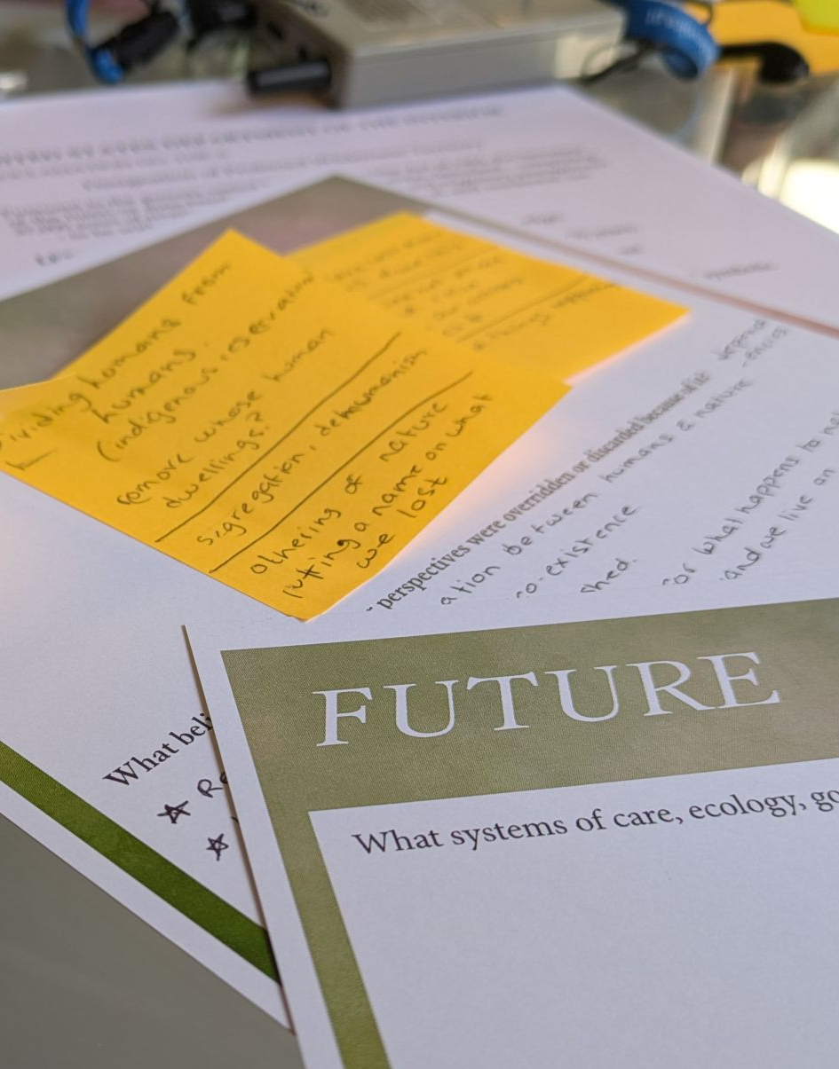

Activation 2
Customer Delight Strategic Session
How do you sell while maintaining customer delight
Audience
Verizon VPs across care, sales and consumer ops — mixed audience reflecting the new org structure 8–15 attendees, Foundever-hosted, intimate working-session format
Why this event
Verizon’s CEO is pushing customer delight as the core model. Customer care org now rolls up under sales leadership again, creating pressure to keep selling without losing the service experience. New leaders seem to believe there may be a way to increase sales while still keeping a customer-delight focus.
Objective
Strengthen Foundever's position in the supplier consolidation (9 → 4 partners) — be in the top 4 Generate a co-authored point of view Verizon can use internally to align care + sales
Message
Working line: "You don't have to choose between selling more and delighting customers" Working session: how leading CX organizations maintain customer delight while hitting commercial targets
Marketing OPS
TBD

Slide 32
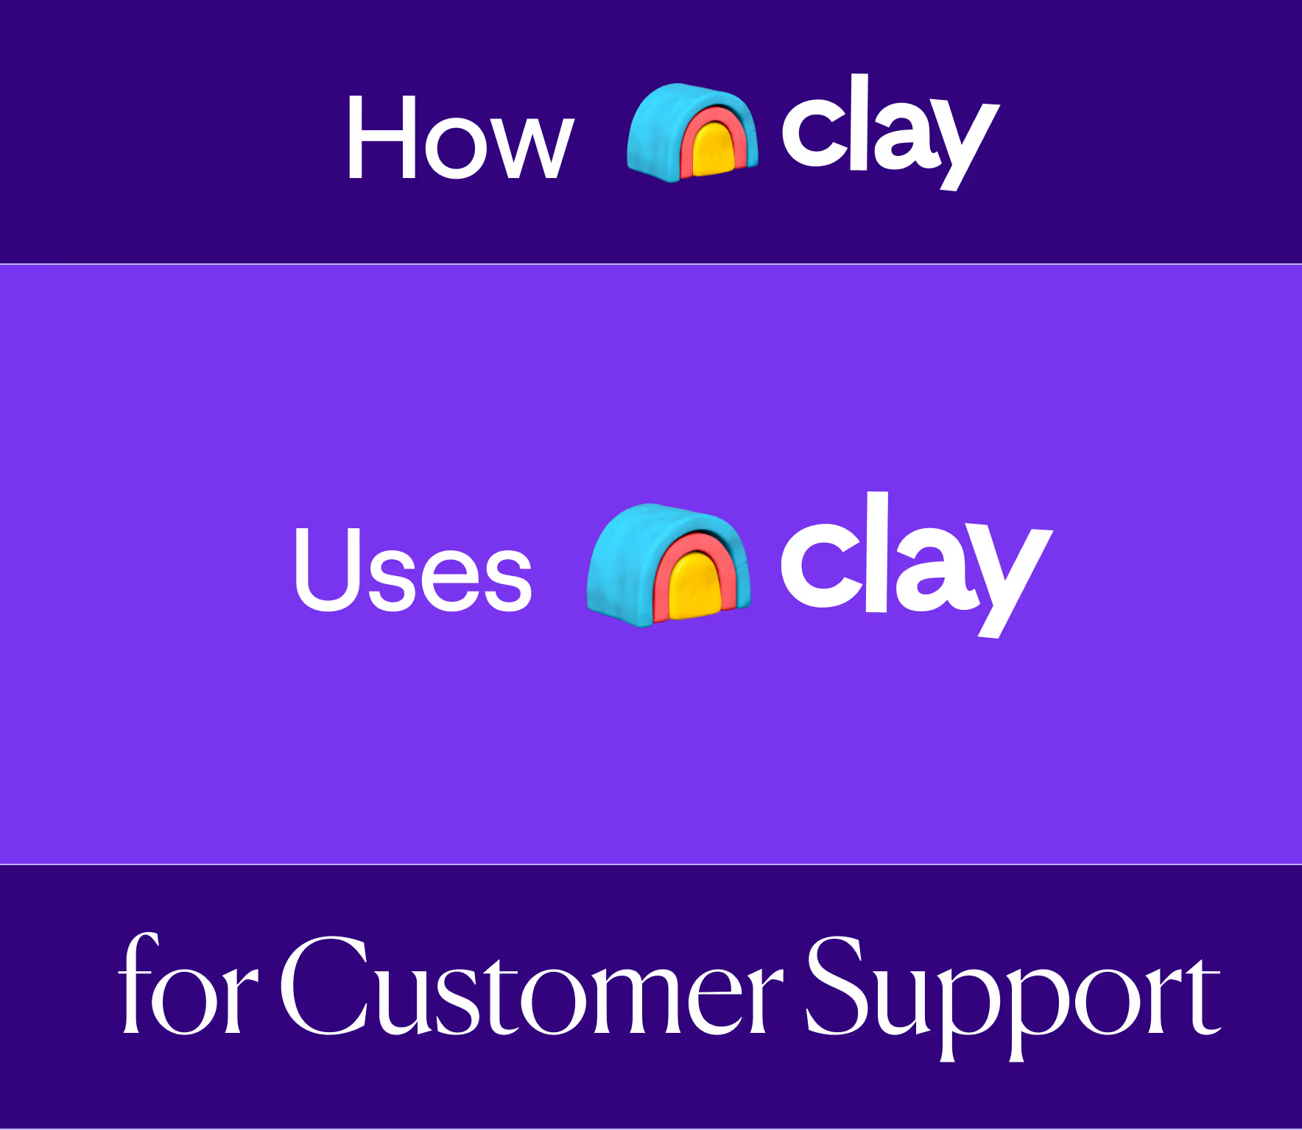
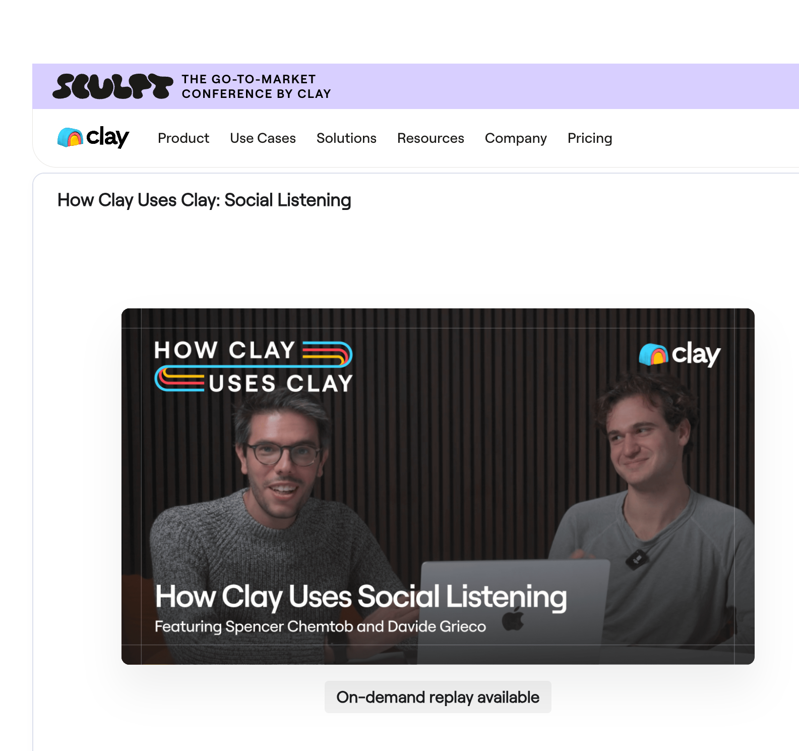
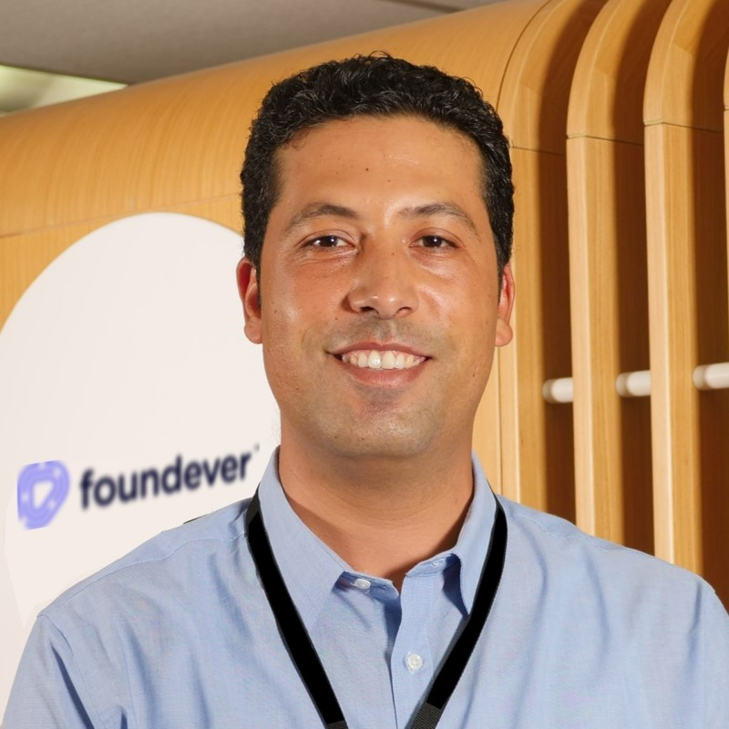
Agent-centered AI:
What we learned from scaling AI across 50,000 agents
Activation 3
Webinar Series:
What we learned from scaling AI across 50K agents
Audience
VP+ ops, transformation, AI and workforce leaders — Verizon plus open invites across Telco, BFS, Tech 30–60 attendees online Real target: getting senior Verizon people in the room who'd never show up for a Foundever-only thing
Why this event
Verizon is cutting 35K agents down to 15K in two years, moving toward AI and consolidation of partner space. Foundever would not be involved in “building their AI” because Verizon does that internally – but it could be involved in operationalizing it Online/hybrid format lowers the barrier for SVPs to attend (no travel, lower commitment)
Webinar/Substak
Objective
Secure 5–8 senior executive 1:1 follow-up meetings with Verizon SVPs+ within 60 days Close the SVP+ gap flagged by Ryan in May 2026 discovery Position Foundever as a peer convener (not vendor
Message
Good AI solutions remain just a pilot and fail to enable agents if they’re not build with agent-centric data in mind. Even if you want to build your AI, you need to have the right CX analytics

Slide 33
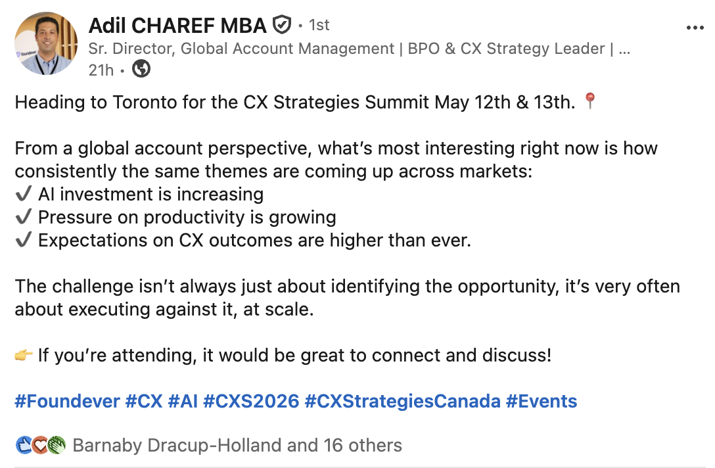
Agent-facing AI:
How to deploy it within your CX ecosystem
Activation 3
Social Amplification Kit: Expand our SMEs voice to market
Telco Insights
Objective
Drive engagement across all the stages of the funnel through social listening Position Adil as the go-to voice on Telco CX expert Use LinkedIn organic as a tool to increase reach and traffic for the key pieces of content.
CTA
Primary: Drive-to our current campaign assets Secondary: Talk to an Telco CX expert (30-min working session)
Marketing Ops
Hosted: LinkedIn organic Distribution: LinkedIn Sponsored Flow: The visitors are pushed to a "Talk to an expert" CTA, which routes to a mid-funnel thank-you page. Non-converters get retargeted across LinkedIn and display.

Slide 34

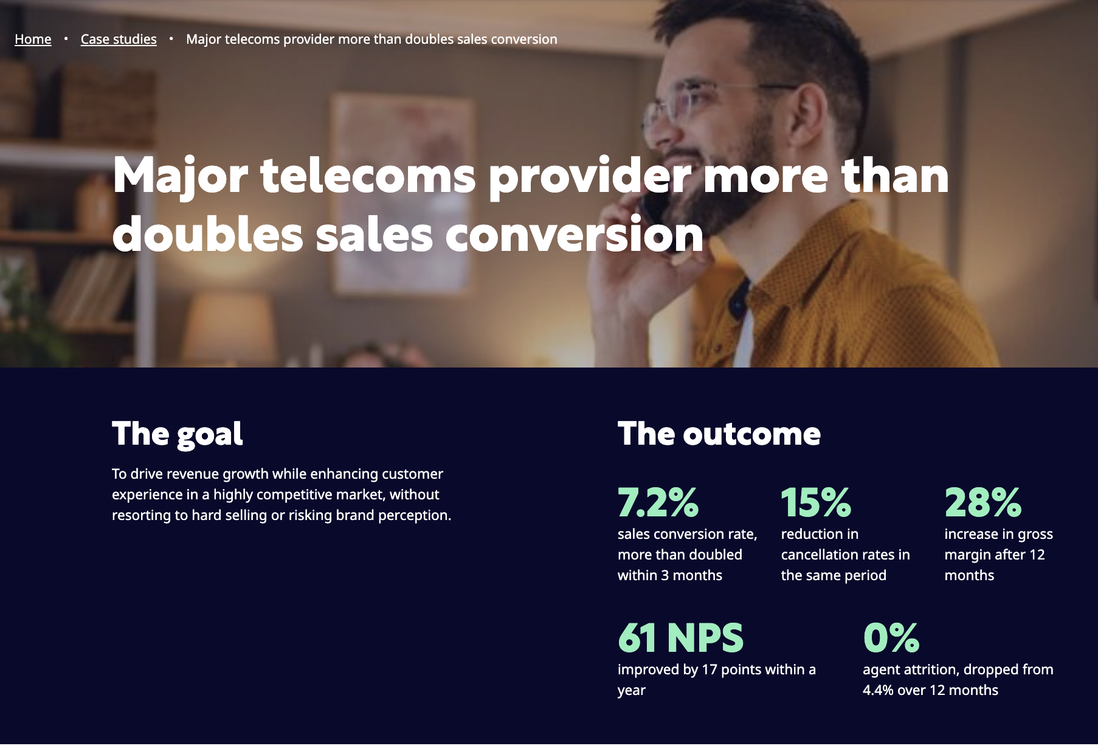
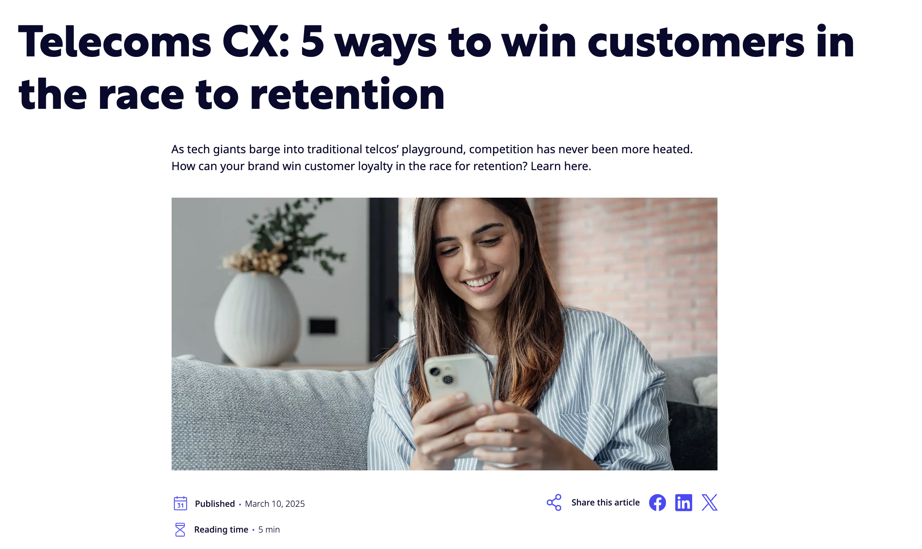
Developing content to fill in the gaps
Current audit of what we have, and what we need to create:
Assets | Test | Inform | Educate
Ready to deploy | 0 | 2 (articles) | 2 (case studies)
To update | 1 (eBook) |  | 1 (Foundever LP)
To create from scratch | 4 (Display ADs) 2 (emails) | 3 (articles) 3 (emails) 1 (expert video) 4 (Display ADs) | 2 (emails) 1 (Event - Roundtable & Consortium Planning ) 1 (Event - Innovation Day Planning)
We have a strong foundation of existing content to support the inform and educate stages
For ABM programs, recommending discussing with sales on the best nuances to bring to market based on the markets

Slide 35
ABM Verizon
Personalized Thought Leadership Formula
Whitespace
Persona
Sales Intelligence first 30 days
Customer Delight
x
Sales Generation
x
Operation Pod
C-level
x
Procurement
x
CX
x
x
Notes:
Ad 1 – Question (Q) & Statement (S)
Q A: Is your organization prepared for the next wave of change?
Q B: Are you positioned to turn the next disruption into an opportunity?
S: Unlock the power of AI for unmatched support, flexibility and resilience.
Ad 2 – Question (Q) & Statement (S)

Slide 36
3- Social
Media Plan
-
Keeping brand promises.

Slide 37
Agent-facing AI:
How to deploy it within your CX ecosystem
Activation 3
Social Amplification Kit: Expand our SMEs voice to market
Telco Insights
Objective
Drive engagement across all the stages of the funnel through social listening Position Adil as the go-to voice on Telco CX expert Use LinkedIn organic as a tool to increase reach and traffic for the key pieces of content.
CTA
Primary: Drive-to our current campaign assets Secondary: Talk to an Telco CX expert (30-min working session)
Marketing Ops
Hosted: LinkedIn organic Distribution: LinkedIn Sponsored Flow: The visitors are pushed to a "Talk to an expert" CTA, which routes to a mid-funnel thank-you page. Non-converters get retargeted across LinkedIn and display.

Slide 38
Social Media Plan
Overview of key steps
Event
Who’s posting –
us or them?
What we need from you
What we build
for you
Once, at the beginning
Weekly LinkedIn posts
30-min interview (once)
2x posts per week
Define together what we need to build content pillars for your specific ABM play.
Written in your voice, tied to our telco campaign themes: convergence, AI in CX, outcomes vs hours.
Key steps to drive social amplification and engagement for the ABM and new logos plays.
Weekly basis
Opinion articles
15-min content review
2x articles per month
2 - months commitment
Every piece of content goes out under your name, so you sign off first. No surprises.
Longer-form content to build your authority in the telco space and drive engagement.
30-m stakeholder engagement
Relationship mapping
Vet & engage the main stakeholders of the target account.
Overview of execs.
Relationship mapping based on the key stakeholders to engage with.

Slide 39
Workflows
-
Keeping brand promises.

Slide 40




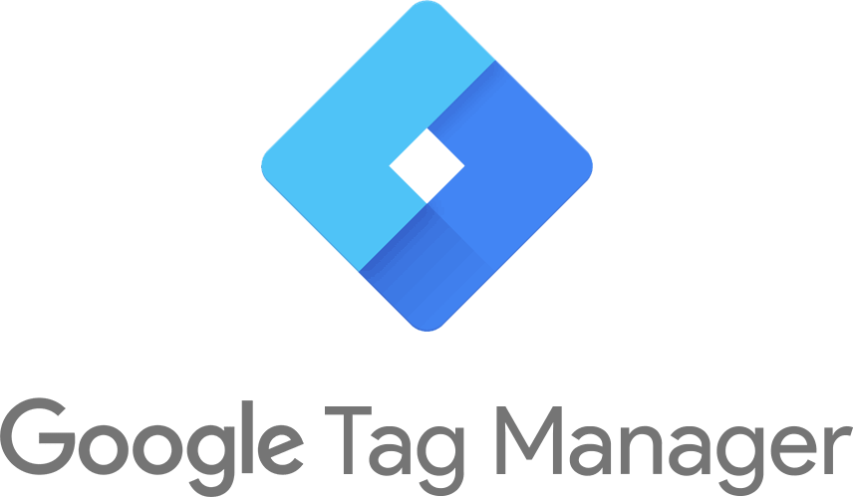

Workflows
Landing Page
Sales Report on engagements
Thank you page
Inside sales inbound motion
Results
Snapshot
Traffic sources
Converts
Influ2
ABM
Convert interest into meeting
LinkedIn
Organic
Landing Page
Visit
Quiz
Form fill via
LinkedIn
paid
Doesn’t convert
Doesn’t Convert
Direct Sales: Cassidy
SEA
intent
Retargeting cohort
LinkedIn + Influ2
Influ2 Cadance
Notes:
Executive Summary & Key Metrics
2–3 major achievements
1–2 key challenges or risks
At-a-glance dashboard: top KPIs (brand awareness, campaign reach, digital engagement, lead generation)

Slide 41
Pattern 1 — Throughput friction (speed + experience)
 | A1 — Growth-Blocked Operator | B1 — Throughput-Drag Operator
Buyer lens | Earnings (Grow your book) | Cost (Minimise cost to serve)
Diagnosis | "You're acquiring customers, but losing them in the journey. Speed and friction are costing you conversions, NPS, and renewals." | "Routine and easily-automatable work is consuming high-cost agent capacity. Cycle times and repeat-call rates are dragging unit economics."
Sales conversation angle | Revenue protection + LTV | Capacity efficiency + cost per call
Solutions | Real-time conversion assist · First-contact resolution · Empathy-trained licensed claims specialists · Save desk + proactive outreach + NPS tracking | AI deflection of low-complexity calls · First-contact resolution · FNOL training + accuracy-focused agent assist · Save desk with real-time AI assist
CTA | "Book a call with our growth-ops team" | "See where AI deflection saves you"
Pattern 2 — Risk friction (compliance + knowledge)
 | A2 — Compliance-Bound Operator | B2 — Risk-Buildup Operator
Buyer lens | Earnings (Grow your book) | Cost (Minimise cost to serve)
Diagnosis | "Compliance and capability gaps are blocking your growth. Every new customer adds conduct-risk exposure your operation can't absorb." | "Compliance overhead and capability gaps are creating expensive downstream cleanup. You're paying twice — once for the interaction, again for the remediation."
Sales conversation angle | De-risk growth, accelerate confidently | Eliminate remediation cost
Solutions | Licensed agent hiring + appointing · 100% compliance QA + interaction recording · Embedded QA frameworks · Compliance specialist training | Compliance specialist training · 100% compliance audit + interaction recording · Embedded continuous QA · Specialist compliance teams
CTA | "See how we de-risk your growth" | "Move from reactive to maintained compliance"
Pattern 3 — Cost friction (cost solo)
 | A3 — Margin-Pressured Operator | B3 — Direct-Cost Operator
Buyer lens | Earnings (Grow your book) | Cost (Minimise cost to serve)
Diagnosis | "You want to grow but the unit economics aren't there. Acquisition cost is too high to justify scaling; servicing eats LTV." | "Operational cost is rising faster than business value. You need a cost-to-serve model that flexes with demand and accounts for outcomes, not hours."
Sales conversation angle | Growth-aligned unit economics | Direct cost reduction
Solutions | Elastic specialist teams · AI deflection of routine volume · Specialist save desks (save-risk cohort only) · Claims trend insights → loss ratio | Elastic specialist teams · AI absorbing routine volume · Specialist save desks (cost-justified targets) · Continuous compliance monitoring
CTA | "Model your growth economics with us" | "Quote on outcome-based pricing"

Slide 42
Workflows
GTM Social
TBD
Notes:
Executive Summary & Key Metrics
2–3 major achievements
1–2 key challenges or risks
At-a-glance dashboard: top KPIs (brand awareness, campaign reach, digital engagement, lead generation)

Slide 43
Agent-facing AI:
How to deploy it within your CX ecosystem
Activation 3
Social Amplification Kit: Expand our SMEs voice to market
Telco Insights
Objective
Drive engagement across all the stages of the funnel through social listening Position Adil as the go-to voice on Telco CX expert Use LinkedIn organic as a tool to increase reach and traffic for the key pieces of content.
CTA
Primary: Drive-to our current campaign assets Secondary: Talk to an Telco CX expert (30-min working session)
Marketing Ops
Hosted: LinkedIn organic Distribution: LinkedIn Sponsored Flow: The visitors are pushed to a "Talk to an expert" CTA, which routes to a mid-funnel thank-you page. Non-converters get retargeted across LinkedIn and display.

Slide 44
Thank you
foundever.com | @foundever

Slide 45
Verizon – 90 days plan
PHASE 1: Market Signal Validation
PHASE 2: Conversion Optimization & Asset Expansion
Test –Define which CX challenge resonates most across EMEA and US, build momentum, and activate accounts.
Awareness – Inform the unaware. Position Foundever as the partner for telcos facing these challenges.
Consideration – Bring awareness to Foundever's internal capabilities and market proof points.
Week 1
Week 2
Week 3
Week 4
Week 1
Week 2
Week 3
Week 4
Week 1
Week 2
Week 3
Week 4
Landing Page Telco what if we make this a microsite that only Verizon can see? Focus on Operator Pods
Display Ads + Paid Search
Person-based marketing + Paid Search
ISG Report
Display Ads
Person-based marketing
Article Retention
Display Ads
Person-based marketing
Case Study Revenue Generation (gated)
Display Ads
Person-based marketing
Winning customer delight while increasing sales
Display Ads
Person-based marketing
Whitepaper Gen AI
Display Ads
Person-based marketing
Article Differentiation & Revenue Generation
Display Ads
Person-based marketing
Virgin Media/ Orange? (gated)
Display Ads
Person-based marketing
Getting the
Display Ads
Person-based marketing
Social Amplification - connections, engagement
LinkedIn Posts
Social Media Listening
Social Amplification - content showcasing
LinkedIn Posts
Social Media Listening
Event Activation
Field Marketing

